Slide 1
Vert.x Overview
DataFibers Backbone Tour

Slide 2
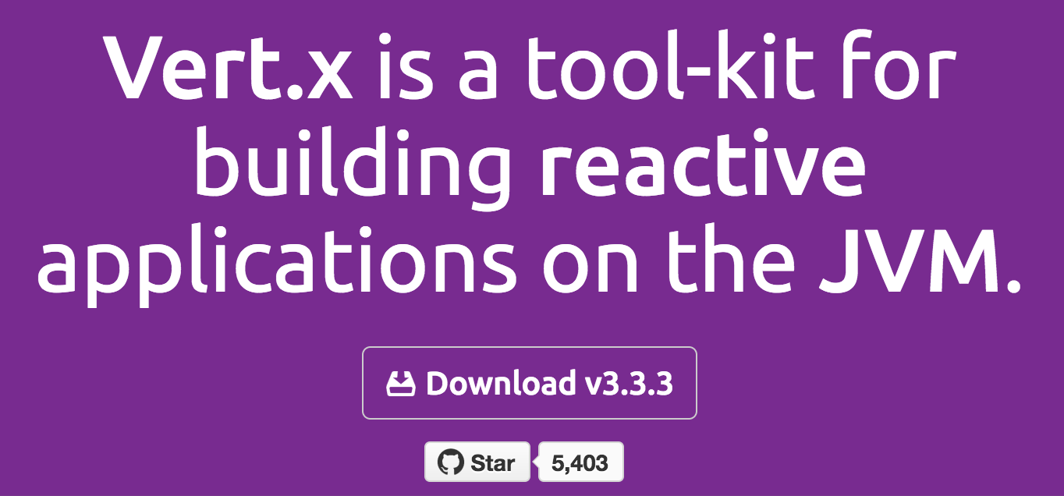
What is VERTX - vertx.io

Slide 3
What is Reactive

Slide 4

Why to Reactive - Problems
Number of mobile users raises
2,1 billion in 2012 -> 7 billion in 2018
Internet of things - 30 billion in 2020!
Threading Issues
One thread handles one task
Thread is waiting for job to finish
Whole queue of tasks waits
Thread pool is blocking
Synchronous sucks

Slide 5


Why to Reactive – The Solution
Series of loosely coupled events
Event that informs that new job/data is waiting
Release thread instead of waiting for IO to be finished
Use non-blocking IO (NIO)

Slide 6
Vert.x Highlight
A light weighted framework and embeddable toolkit ~ 650k
Thread safe concurrent
Scalable asynchronous event driven reactive
Polyglot (Java, JavaScript, Groovy, Ruby, Python etc.)
Event-driven & Non-blocking programming model
Super simple concurrency model
Ideal choice for creating light-weight, high-performance, micro-services
Public module repository
Reactive applications
Asynchronous APIs – database, micro-service, cluster, management, etc.

Slide 7
Vert.x Core Concepts
Event Loop
Verticles
Server Verticles
Worker Verticles
Event Bus
Point to Point
Pub/Sub
Distributed

Slide 8
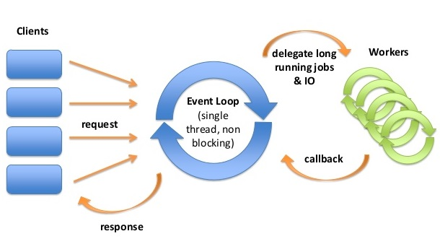
The Famous Event Loop

Slide 9
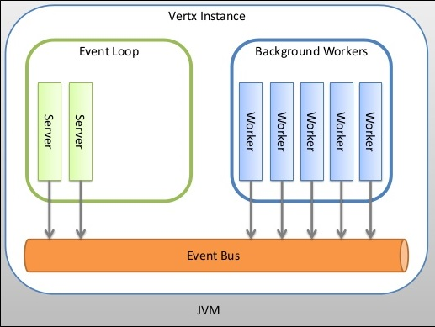
Architecture

Slide 10
Architecture Highlight
Don’t Block the Event Loop
Workers “can” block
Message passing using event bus
Concurrency model
A verticle instance is always single threaded
No more Locking, synchronized & race conditions
Actor-like concurrency model
Scaling
By Creating more Verticle Instances
For TCP & HTTP servers, Vert.x does automatic load balancing
Clustering & EventBus
Use fat jar for deployment

Slide 11
Vert.x Modules
Core
Web
Data Access
MongoDB, JDBC, Redis, MySQL
Authentication Modules
JWT, OAuth 2, JDBC Auth, Shiro Auth, MongoDB auth
Messaging Systems
Kafka, RabbitMQ
Clustering
Hazelcast, Ignite
http://vertx.io/docs/

Slide 12
Vert.X Core
Servers & clients
TCP/SSL
HTTP/HTTPS
WebSocket & SockJS
EventBus
Shared Maps & Sets
Buffers & Flow Control
Container API – Deploy & Undeploy Verticles
Timers & Files
Logging
Configuration

Slide 13
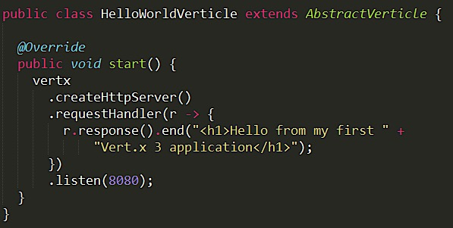
Vert.x HTTP Server – hello world

Slide 14

Vert.x EventBus
EventBus – A messaging API
Two type of messaging
Publish/Subscribe – Publishers delivers the message to all handlers that are registered at the address. Subscribers will all receive the message.
P2P – Vert.x will route it to just one of the handlers registered at that address. If there is more than one handler registered at the address, one will be chosen using a round-robin algorithm.

Slide 15
EventBus Broadcasting Message – P/S
public void start() {
getLogger().info("Broadcaster started");
vertx.setPeriodic(PERIOD_MS, timerID -> {
getLogger().info("Broadcasting message " + counter);
vertx.eventBus().publish(Consumer.CONSUMER_ADDRESS,
"Message " + counter);
counter++;
});
}

Slide 16
EventBus Sending Message – P2P
public void start() {
getLogger().info("Broadcaster started");
vertx.setPeriodic(PERIOD_MS, timerID -> {
getLogger().info("Broadcasting message " + counter);
vertx.eventBus().send(Consumer.CONSUMER_ADDRESS,
"Message " + counter);
counter++;
});
}

Slide 17
EventBus Consuming Message and Reply
public void start() {
getLogger().info("Consumer started! " + hashCode());
vertx.eventBus().consumer(CONSUMER_ADDRESS, message -> {
getLogger().info("Received message: " + message.body());
message.reply("I got your message");
});
}

Slide 18
Vert.x web
Routing
Regex Matching
Request Body Handling, parameters extraction
Cookie Parsing & Handling
Multipart Form & File Upload
Session support ( sticky & non-sticky )
CORS & CSRF Support
Authentication & Authorization
SockJS Support

Slide 19
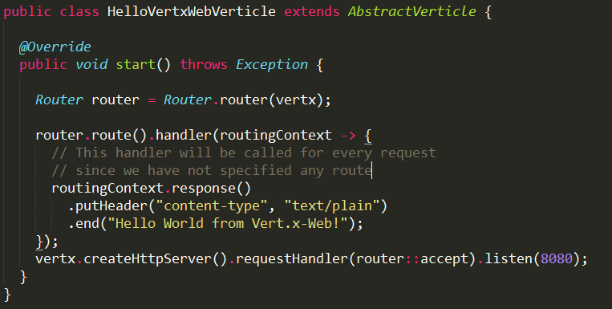
Vert.x Web Hello World

Slide 20
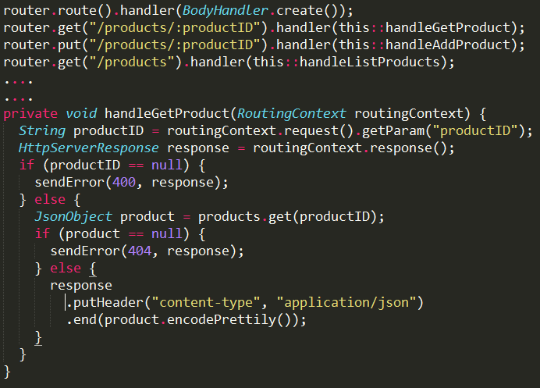
Vert.x Routing

Slide 21
Questions? Thank You ☺

